Slide 1
NODE.JS
(The Backend Of MERN Stack)
Lecture 41

Slide 2
Today’s Agenda
Introduction To Authentication
Introduction To Authorization
Using lodash Library
Understanding Password Hashing
Understanding Salt
Using bcrypt Library
Examples

Slide 3
introduction
In the context of web development, the two concepts: authentication and authorization are extremely important concepts that play a crucial role in `securing applications and controlling access to resources`.
However many beginners often take them to be the same , so lets first understand the difference between them

Slide 4
What is authentication ?
Authentication is the process of verifying the identity of a user.
It ensures that the user claiming to be a particular person is indeed who they say they are.
We perform authentication when a user tries to access protected resources or perform privileged actions.

Slide 5
Different ways of authentication
There are several ways of performing authentication but the most common are:
Username Aand Password:This is the most common method where users provide a username and a password to prove their identity.
Cookie/Session Based Identification: A cookie or session is set for the user on first login and then for future logins authentication is done based on that.

Slide 6
Different ways of authentication
Token Based Authentication: Tokens, such as JSON Web Tokens (JWT), are generated and issued to users upon successful authentication. These tokens are then included in subsequent requests to authenticate and authorize the user.
Social Media Authentication: Social authentication checks the user using the already-existing login credentials for the relevant social network; it does not call for additional security.

Slide 7
Different ways of authentication
Password-Free Identification: An OTP (one-time password) is sent to the user’s email or registered mobile and authentication is done based on that OTP.

Slide 8
What is authorization ?
Authorization determines the actions or resources a user is allowed to access within an application after successful authentication.
Once a user's identity is established, the authorization process enforces the access control rules and permissions to ensure that the user can only perform their authorized actions.

Slide 9
What is authorization ?
For example in a coffee shop a customer and manager play different roles .
A customer can view menu and place order while a manager might also have access to the daily sales totals.
Therefore the system would use their verified identities to grant each user certain access.

Slide 10
Different ways of authorization
Like authentication there are several ways of performing authorization but the most common are:
Role-based access control (RBAC): Users are assigned specific roles (e.g., admin, user), and each role has a set of predefined permissions that determine what actions or resources they can access.
Attribute-based access control (ABAC): Access control decisions are made based on various attributes associated with users like resources, geographical conditions.

Slide 11
Exercise 85
Write an Node-Express-Mongoose application to register a new user in the database through POST request .
The credentials are: name, email and password and he validation needed is:
All three values must be present.
Minimum length of each should be 5.
Maximum length of name and email must be 50 and for password it must be 1024.
Email must be unique and valid.
In case of any exception/problem during query processing return appropriate response code with message.

Slide 12
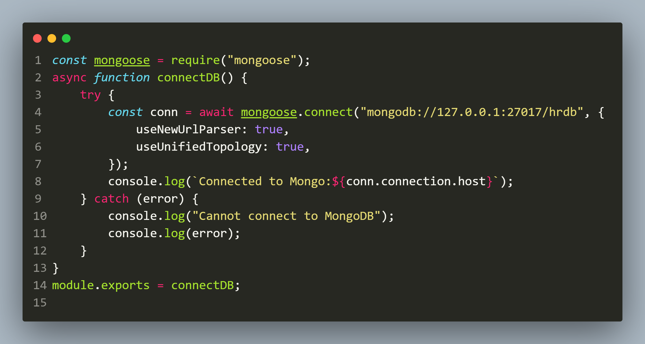
Solution(db.js)

Slide 13
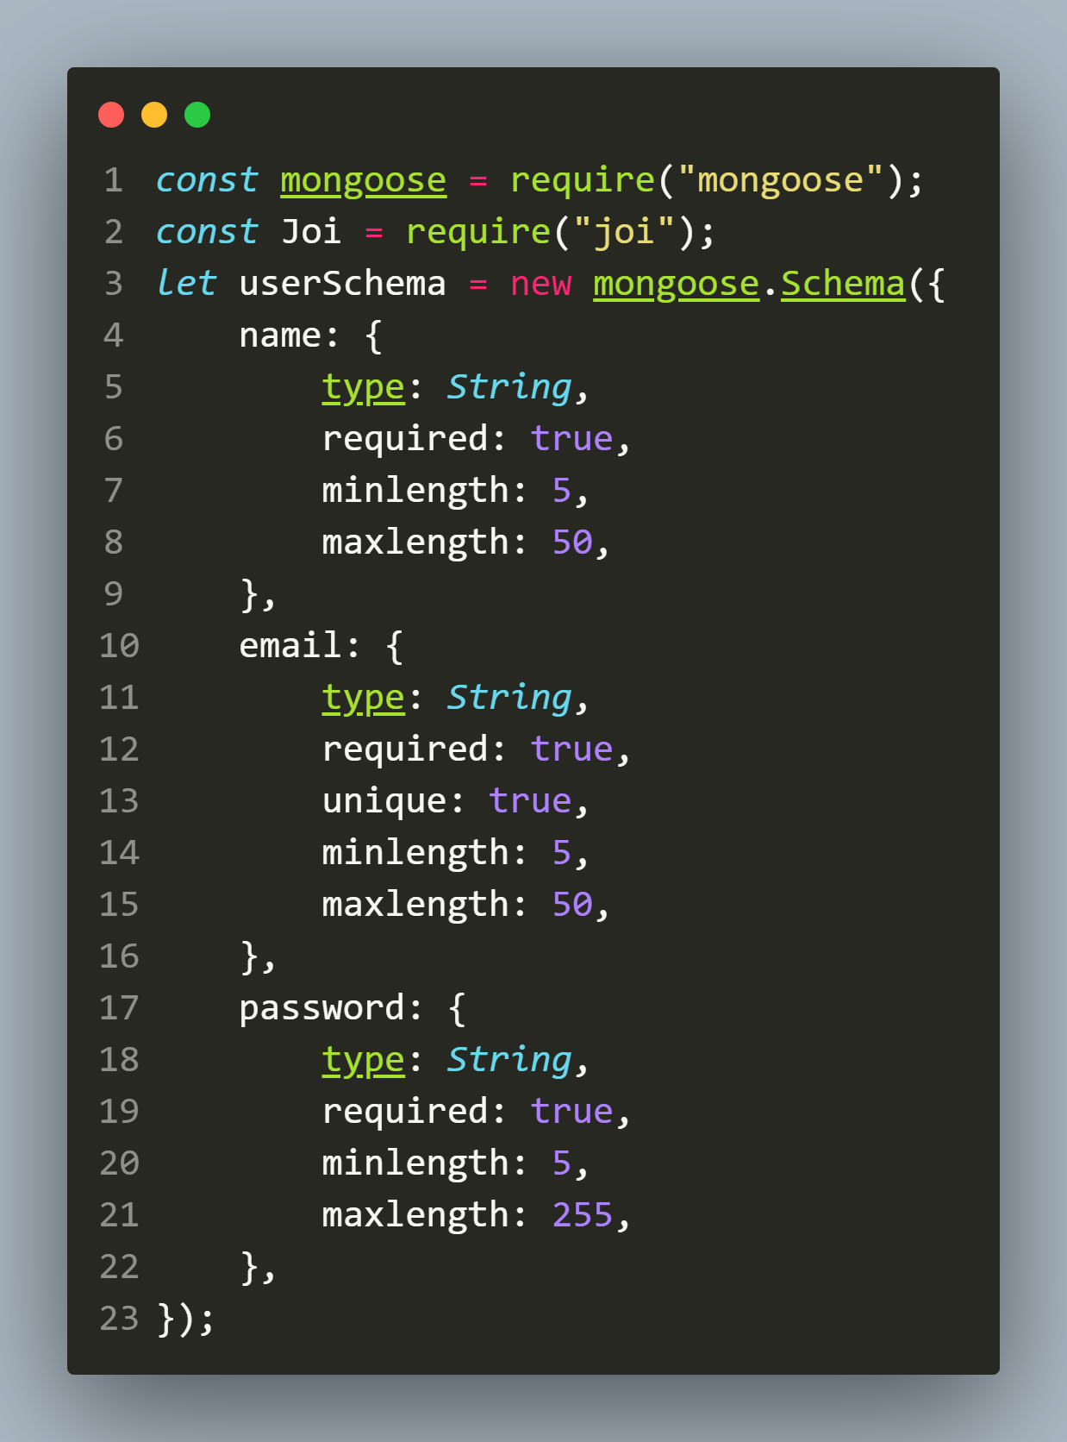
Solution(models/user.js)

Slide 14
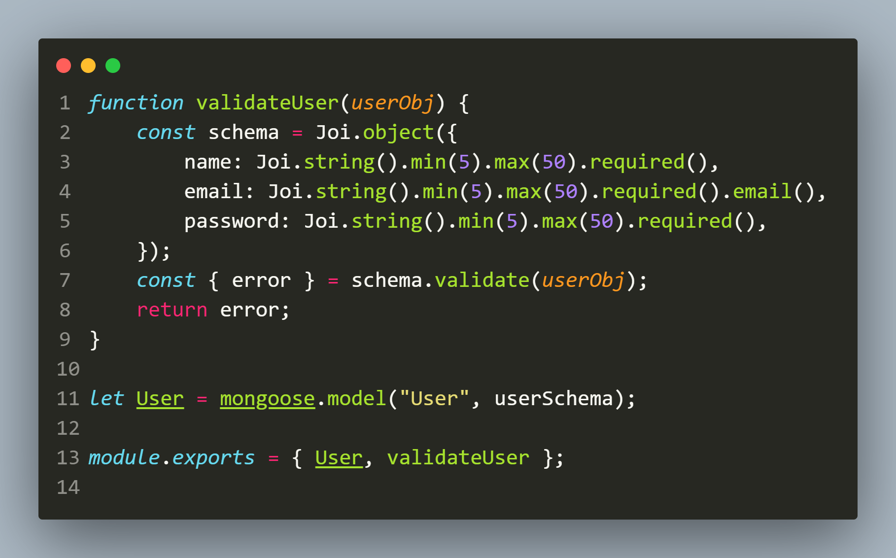
Solution(models/user.js)

Slide 15
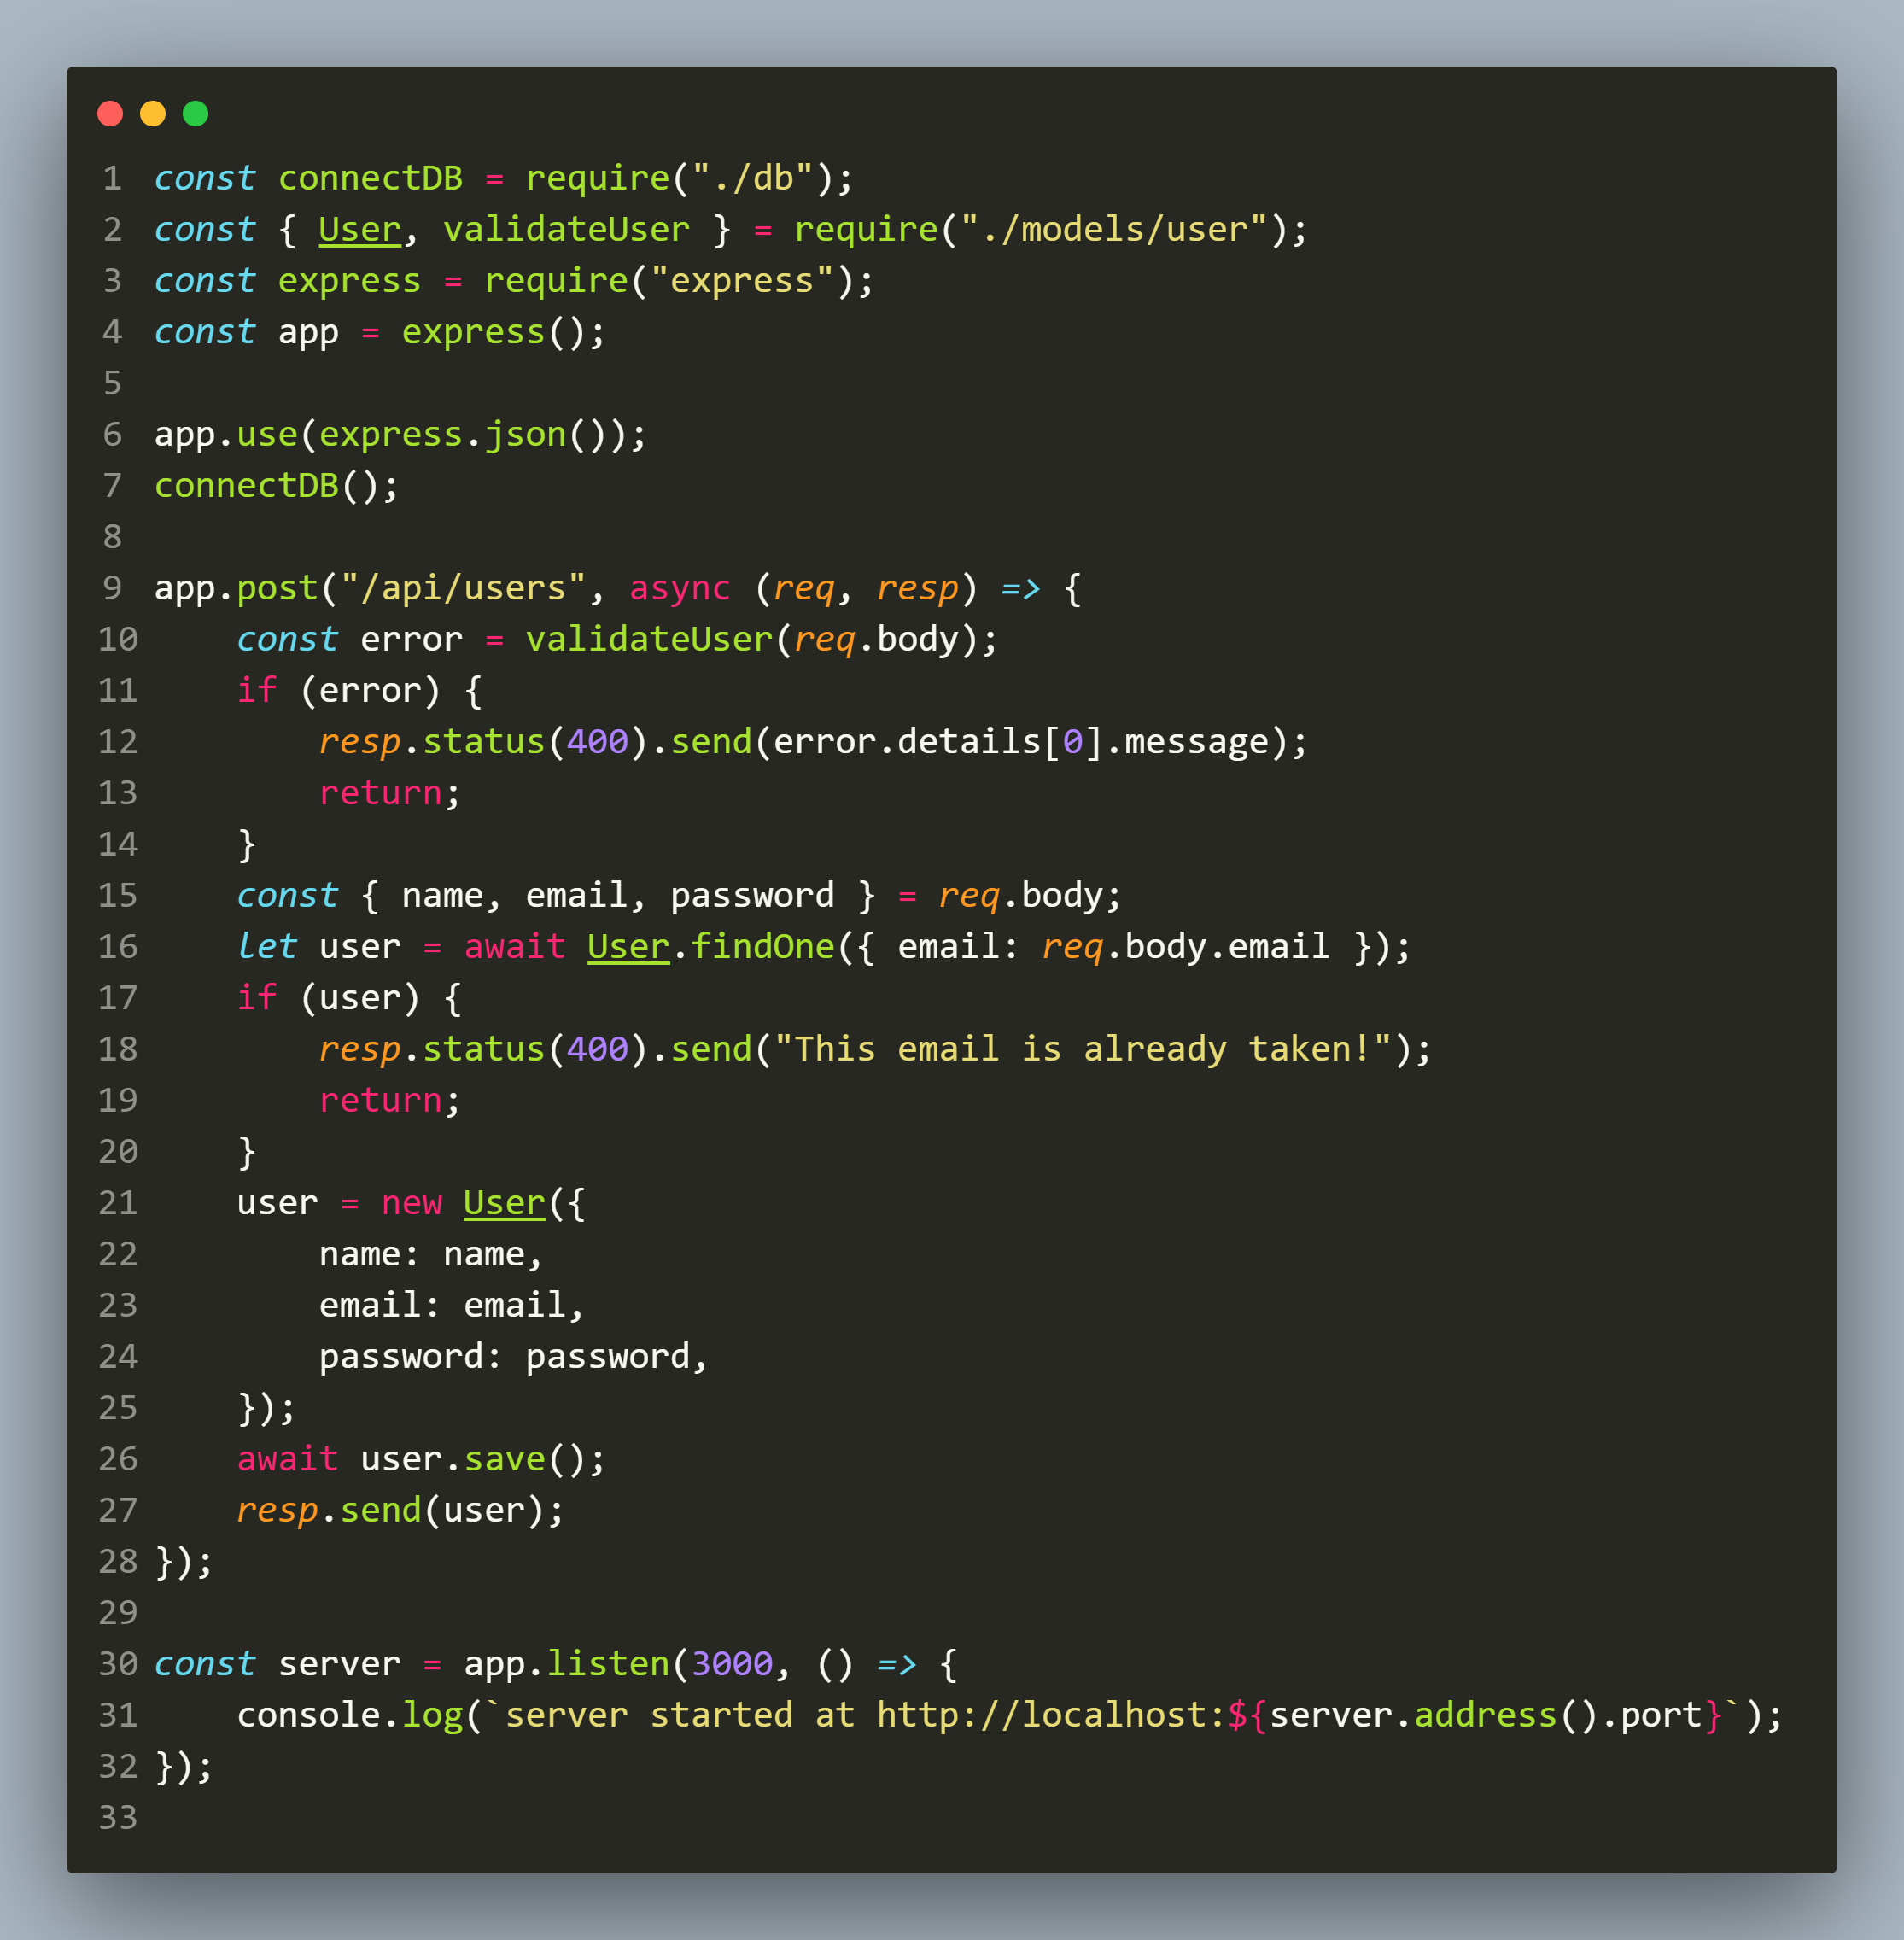
Solution(app.js)

Slide 16
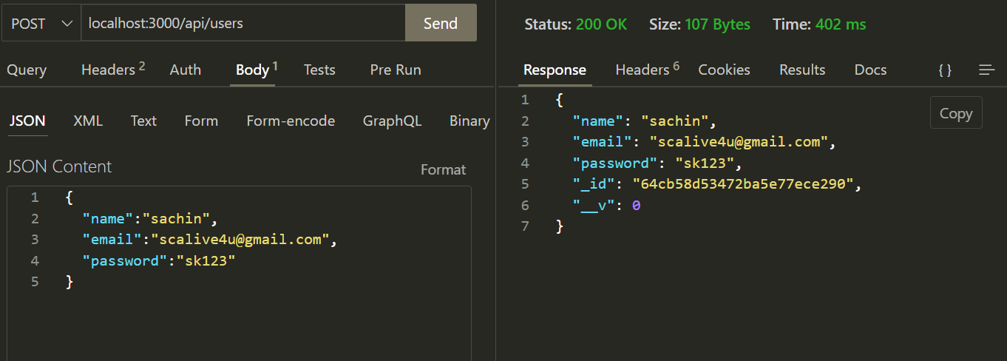
output

Slide 17
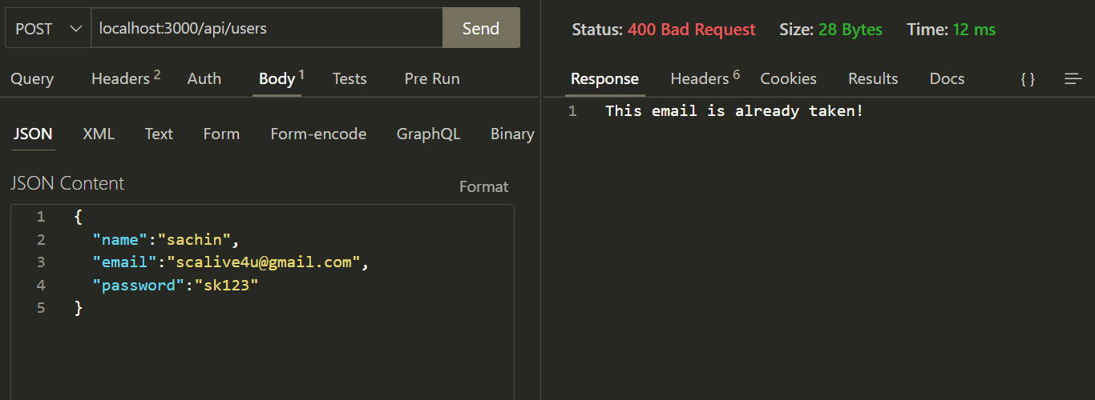
output

Slide 18
Improvement -1
Although the registration code is working fine but it needs certain improvements.
The first one is instead of returning complete object to the client we must return only _id, name and email because password is sensitive data and should not be returned.

Slide 19
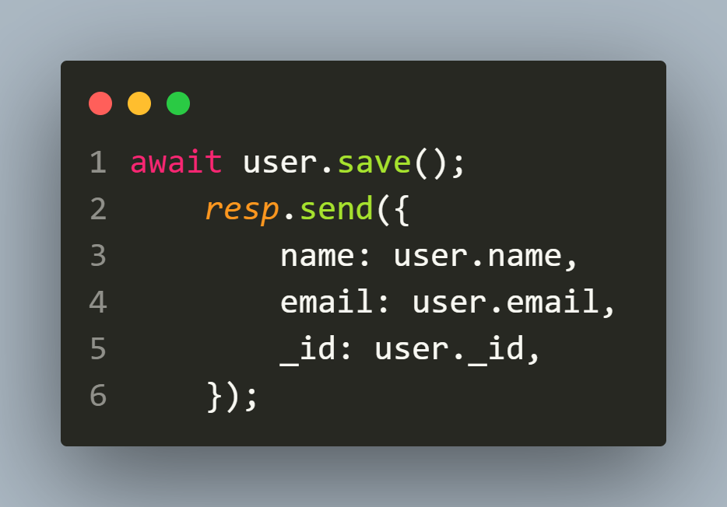
Improvement -1
Although we can do this by simply modifying the last return statement in app.js post route to:
But we have a professional way to do that , and it is using a very popular JS library called lodash.

Slide 20
About lodash
Lodash is a popular javascript based library which provides 200+ functions to work with arrays, strings, objects like drop(), remove(), deep equality checks, and so on.
What we require from lodash is a method called pick().

Slide 21

InstallIng lodash
We can install lodash in the following way :

Slide 22

Using lodash
To use lodash we need to import it using require() which will return an object.
Although we can use any name for receiving it but the convention is to use _ as shown below:

Slide 23
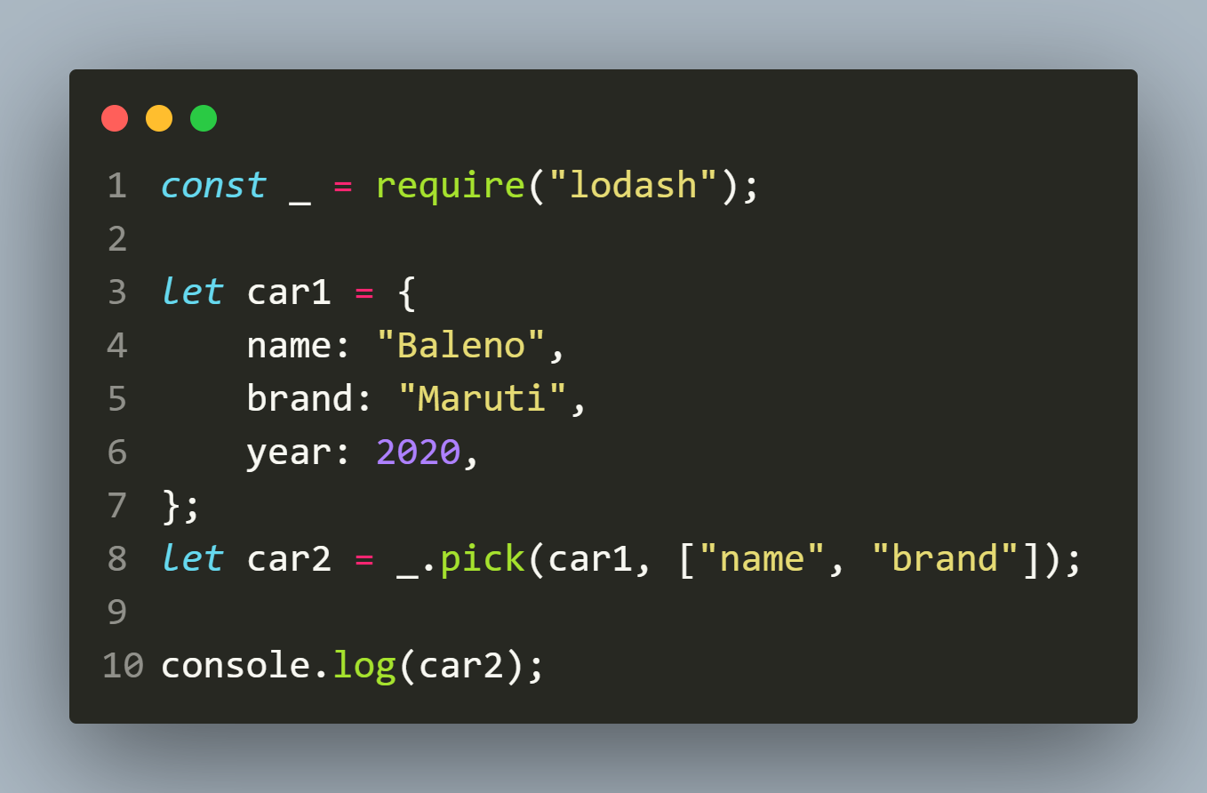
About pick()
The pick() method is used to return a copy of the object that is composed of the picked object properties.
Code:
Output:

Slide 24
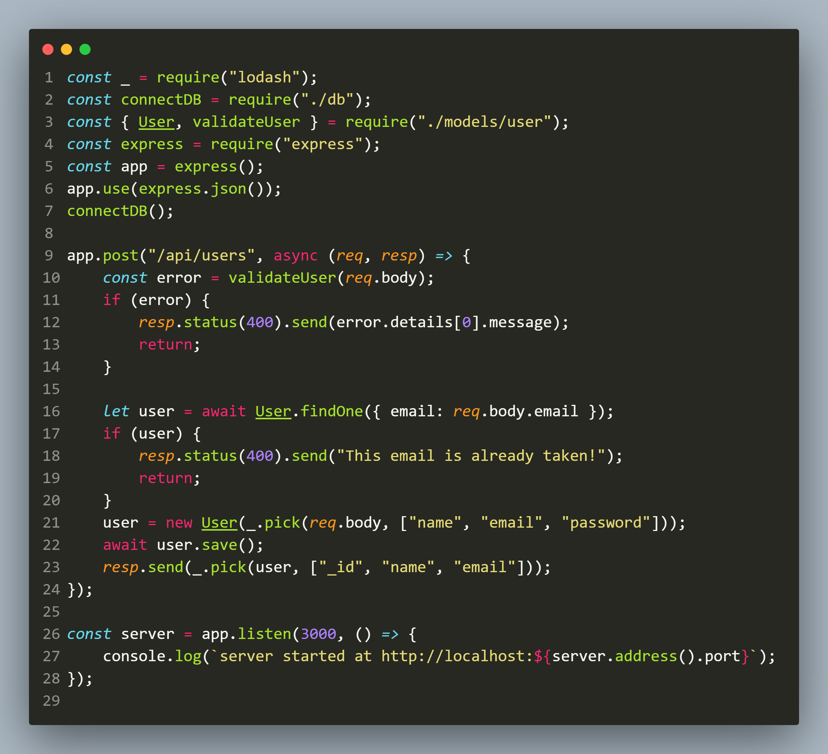
Improved app.js

Slide 25
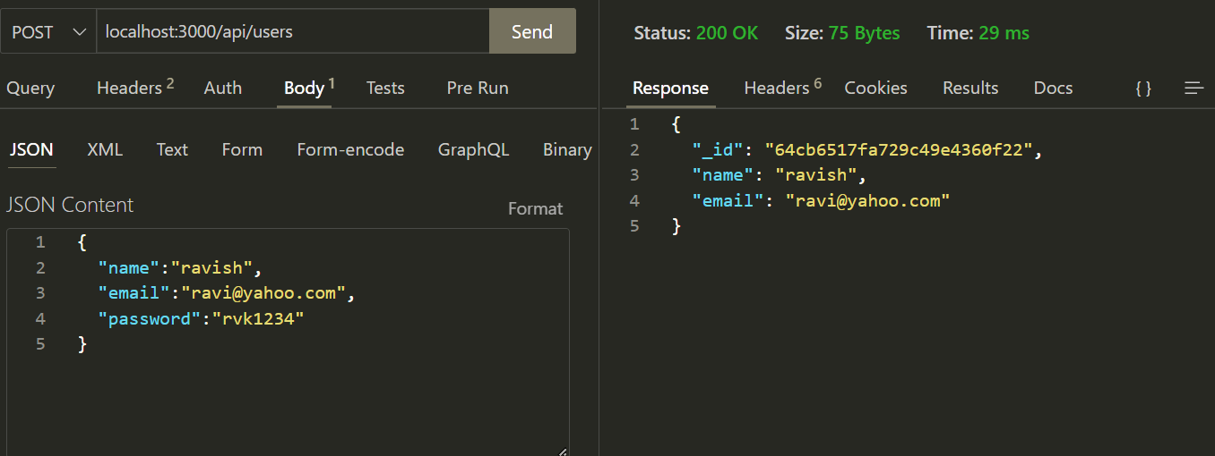
output

Slide 26
Improvement -2
The next improvement our code requires is in the way we are storing passwords.
We have stored password in plaint text in the database and this imposes a very severe security threat.
That's because if a hacker gets access to the database then he can see the passwords stored in the database and do whatever he wants.

Slide 27
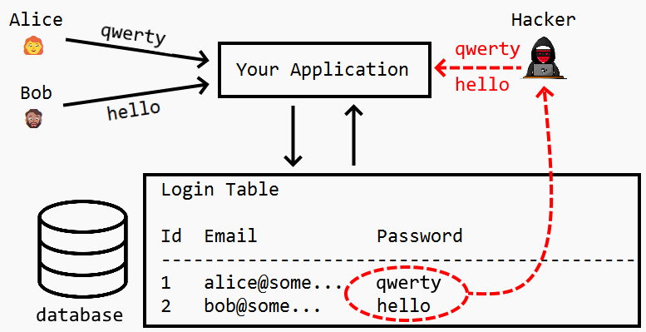
Saving password in plain text is dangerous

Slide 28
Improvement -2
Solution:
Use a technique called Password Hashing to store the passwords in the database.
This way passwords will be more secure as compared to plain text.

Slide 29
What is password hashing ?
Password hashing is turning a password into alphanumeric letters using specific algorithms.
With hashing, even if the hacker gets access to the database he gets the password in hash format, and hashed data is unintelligible.
Some popular algorithms for password hashing include bcrypt and SHA ( Secure Hash Algorithm).

Slide 30
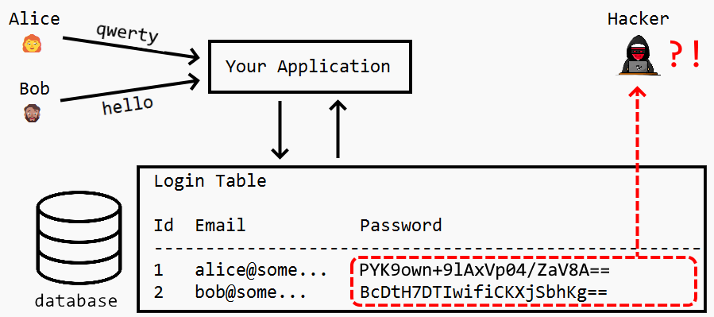
Hashing makes password secure

Slide 31
Is hashing same as encryption ?
No , not at all.
When we encrypt a password we use something called an encryption key to generate the encrypted password.
Now , if a hacker gets access to the encrypted password, he won’t be able to use it immediately.

Slide 32
Is hashing same as encryption ?
But encryption is a two-way street.
Meaning that the encryption key can be used to decrypt the passwords back to plain text.

Slide 33
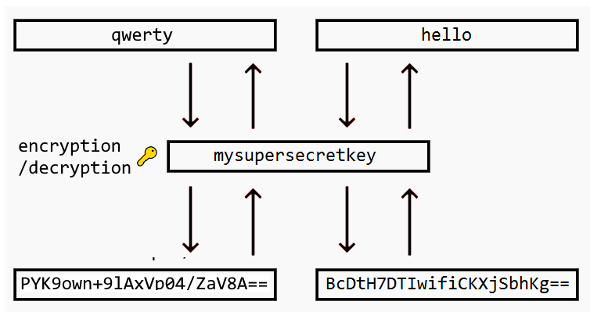
Is hashing same as encryption ?

Slide 34
Is hashing same as encryption ?
Unlike encryption, the technique of hashing is a one-way street.
When we run a user’s password against a one-way hashing algorithm, the result is a random string of text that cannot be reverse engineered or traced back to the original plain text password value.

Slide 35
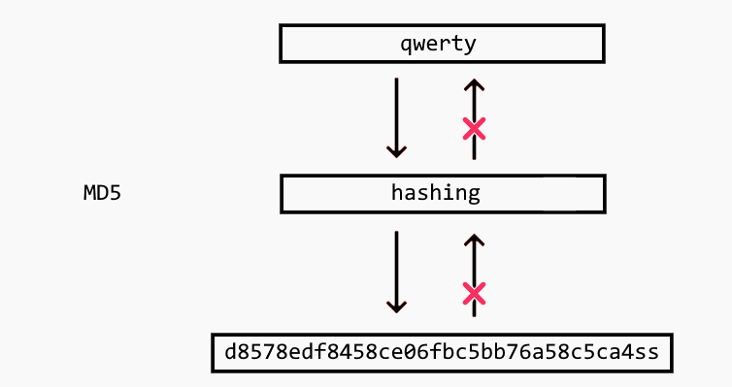
Is hashing same as encryption ?

Slide 36
How hashing works ?
When a user creates a password, the application runs it through a hashing algorithm and stores that random string value in their database .
Now when the user logs in, the application runs the same hash function against the user’s submitted plain text value to check if the resulting random string is the same random string stored in its database.

Slide 37
Is hashing 100% secure ?
No , it’s possible to crack hashed passwords.
Some cyber attacks, such as brute force attacks or rainbow tables can help a hacker get the original password.

Slide 38
What is a rainbow table ?
A rainbow table is a collection of hashed strings for common passwords.
The hacker can then use the table as a lookup, to see if the compromised database password hash exists in the table and then trace that hash chain backwards to identify the original plaintext password.

Slide 39
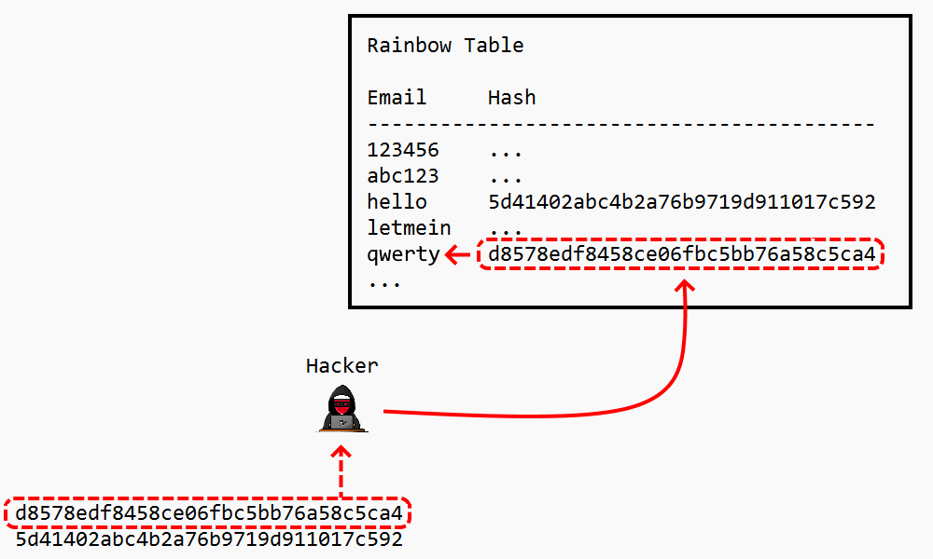
What is a rainbow table ?

Slide 40
Solution-use salt
To better protect passwords from attacks, we add something called a salt.
A salt is a sequence of additional characters that we combine with the password and then this combination goes through the hash algorithm to create the hashed password.

Slide 41
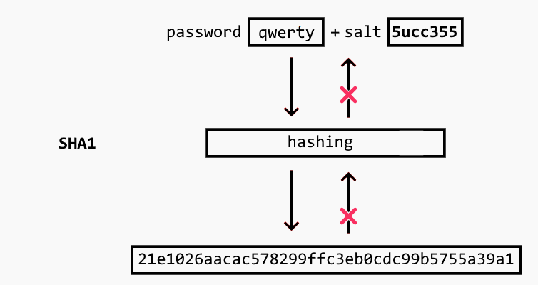
Solution-use salt
So now, even if a hacker obtains the hashed password, it will take him a considerable amount of time to discover the original password that generated it.

Slide 42
What is bcrypt?
Bcrypt is a password hashing algorithm designed by Niels Provos and David Mazières based on the Blowfish cipher.
The name “bcrypt” is made of two parts: b and crypt, where b stands for Blowfish and crypt is the name of the hashing function used by the Unix password system.
Blowfish is an symmetric encryption algorithm that splits text into blocks of 64 bits, and encrypts each block individually.

Slide 43
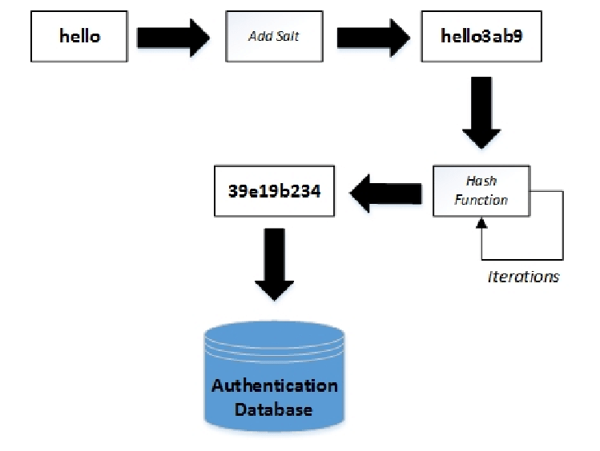
How bcrypt works ?

Slide 44
Using bcrypt
Following are steps needed to use bcrypt hashing algorithm in a Node.js application:
Install the bcrypt package using :
npm install bcrypt.
Import it in the code using :
const bcrypt=require(“bcrypt”);
This will return the bcrypt object and this object has 3 methods we need to call: genSalt(), hash() and compare()

Slide 45
Generating hashed password Using bcrypt
All these methods return Promise object.
The genSalt() method accepts an integer value known as saltRound and returns a salt key to be used in hashing of our password.
const salt = await bcrypt.genSalt(10);
The integer value helps bcrypt in calculating the number of repeated hashing loops done which is actually Math.pow(2,saltRound)

Slide 46
Generating hashed password Using bcrypt
Then we call the method hash() passing it 2 arguments which are the original password and the salt and it returns us the hashed password:
const hashedPwd = await bcrypt.hash(password, salt);
Finally we can save this hashed password in the database.

Slide 47
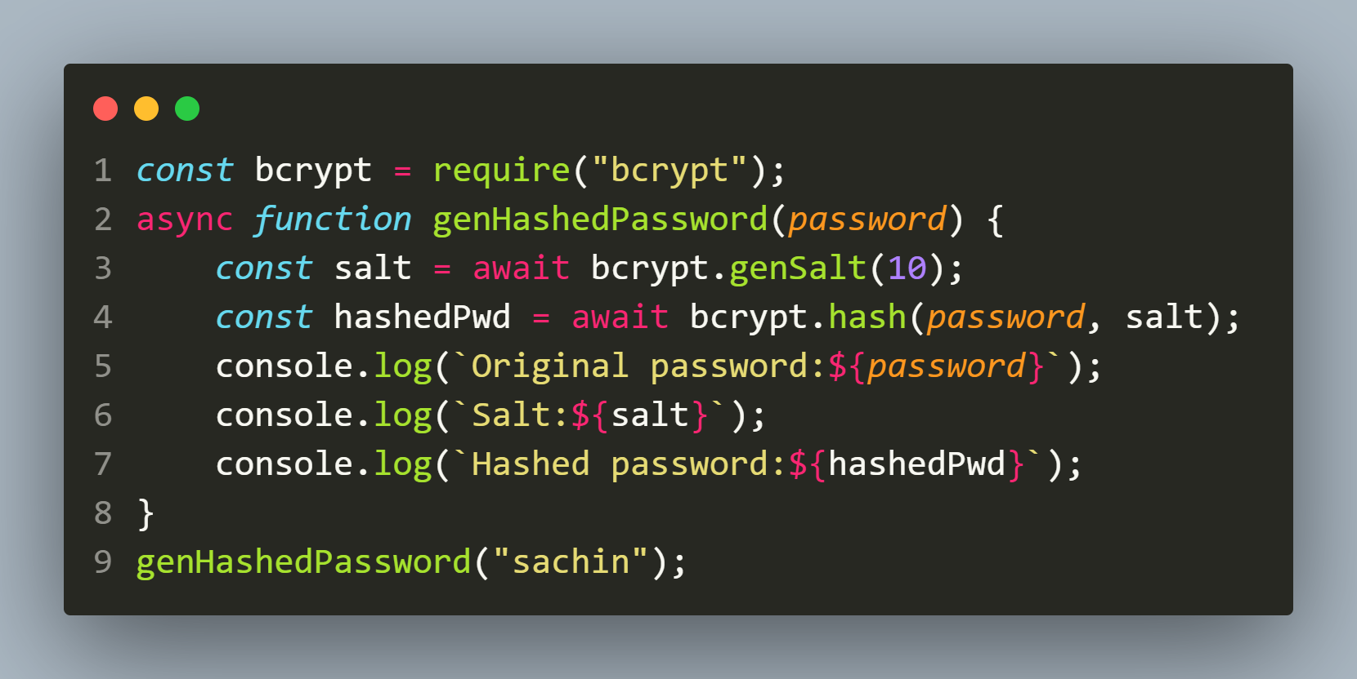
example
Code:
Output:

Slide 48
Comparing passwords Using bcrypt
Now when the user logs in then to compare the actual password with the hashed password we can call the method compare() of bcrypt object.
This method accepts 2 arguments :original password and hashed password, compares them by applying salt on the original password and then returns true or false.
const result = await bcrypt.compare(password, hashedPwd);

Slide 49
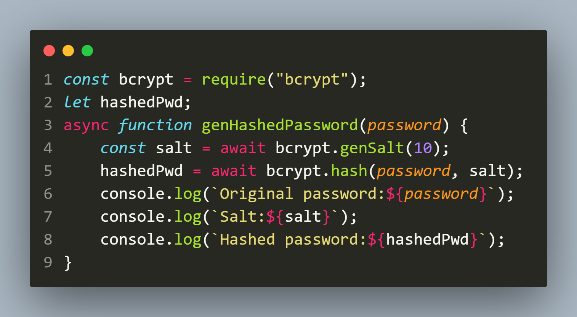
example
Code:

Slide 50
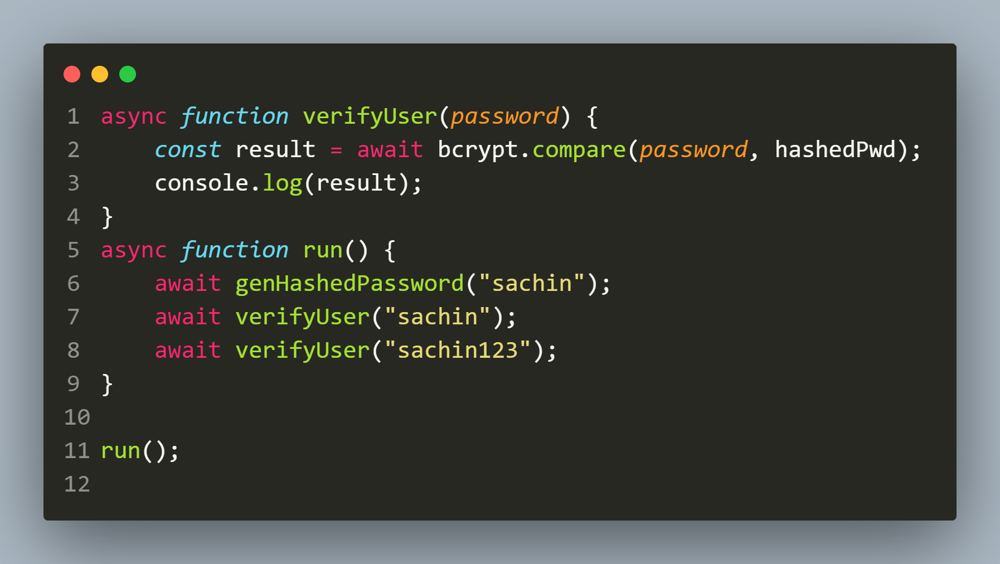
example
Code:

Slide 51
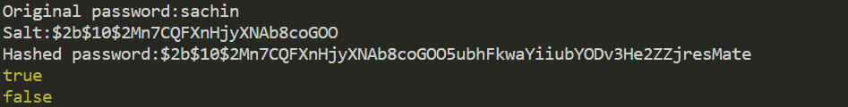
example
Code:
Output:

Slide 52
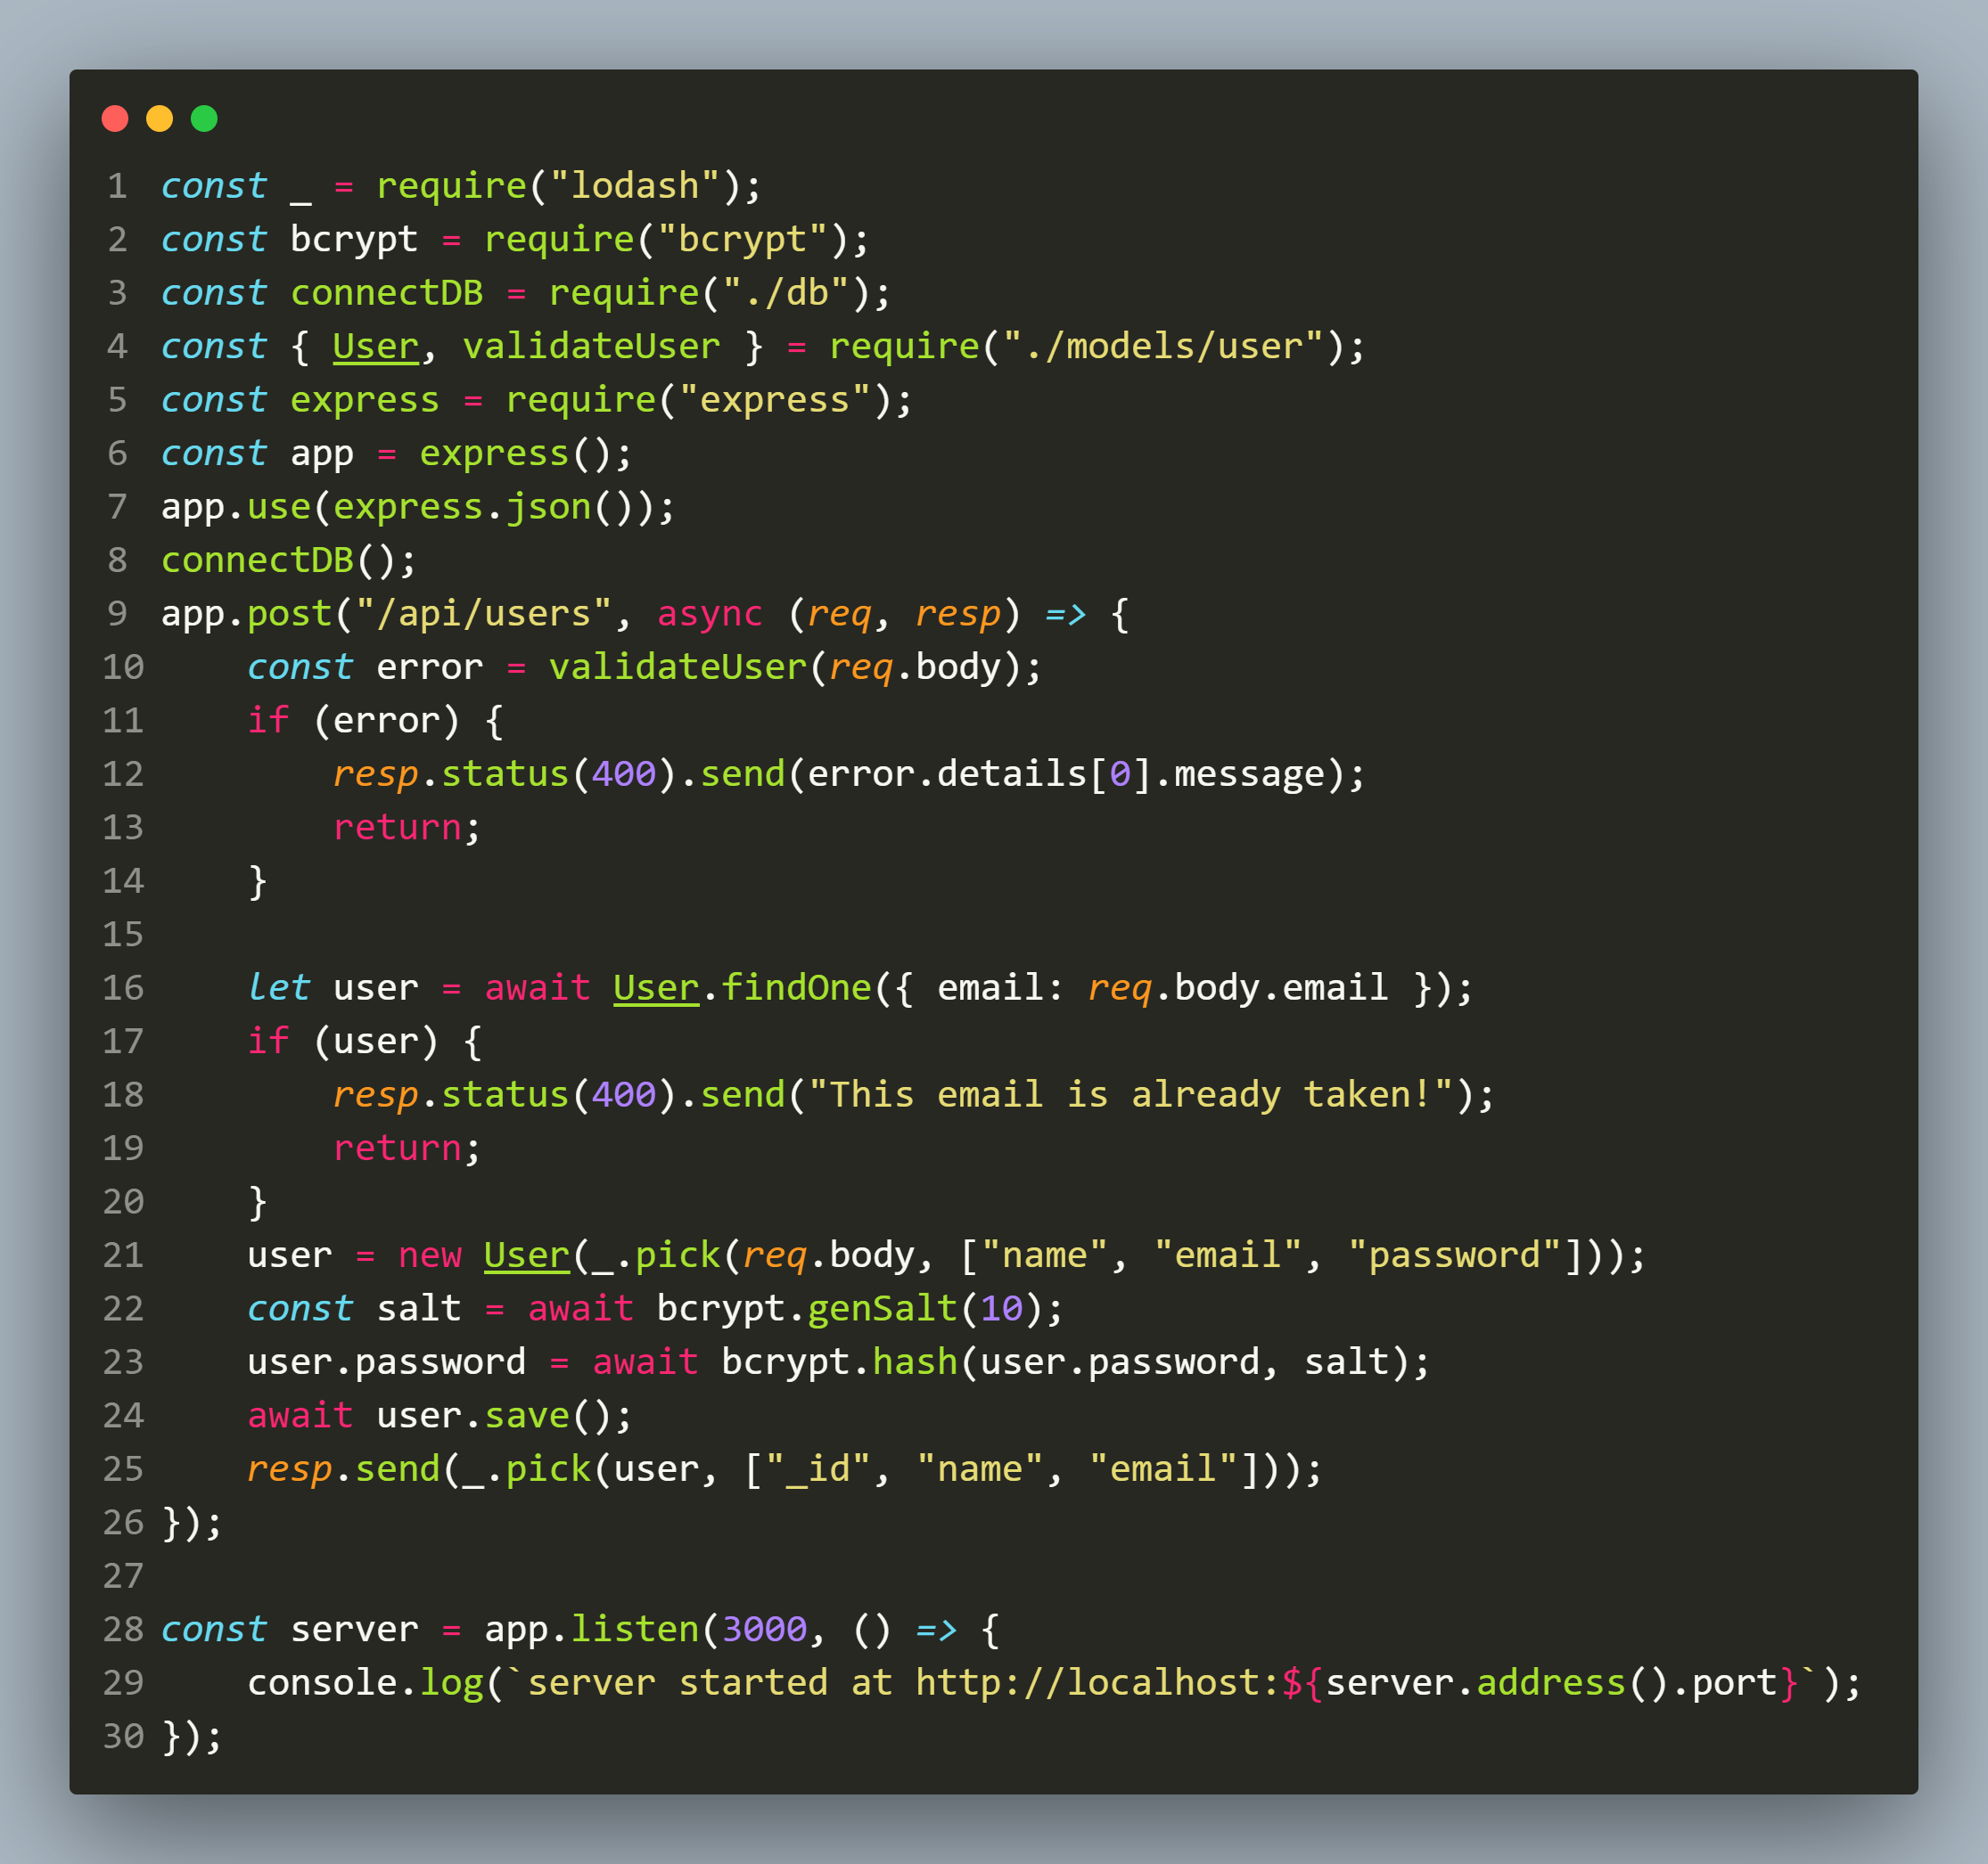
Improved app.js

Slide 53
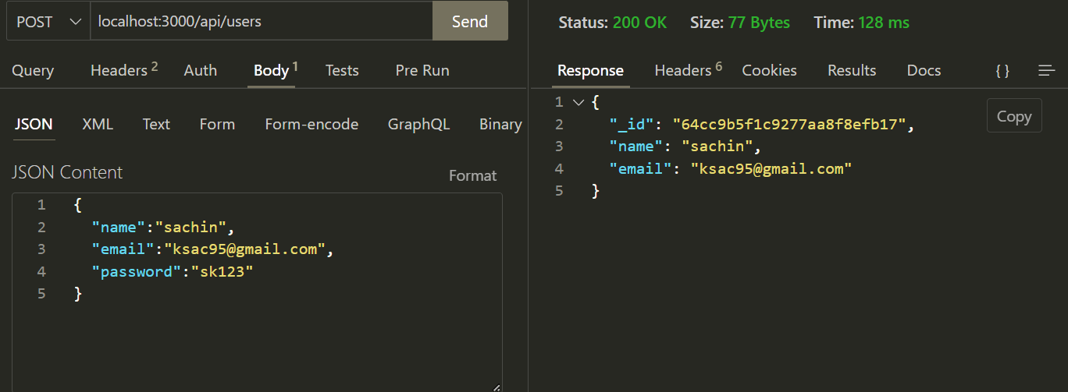
output

Slide 54
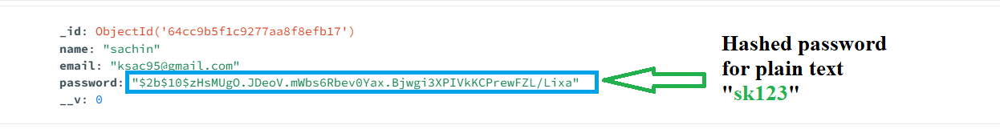
Database entry

Slide 55
Handling login
To handle the login functionality we simply have to do the following:
Define a POST route since login request will contain email and password.
Validate whether email and passwords are present and in valid format or not.
If not then return the error message.

Slide 56
Handling login
Otherwise search the database for the required email.
If not found then return the message “Invalid userid/password”
Otherwise use bcrypt.compare() to match the password supplied by the user and the hashed password in the database.
If matched then return true , otherwise return the message “Invalid userid/password”

Slide 57
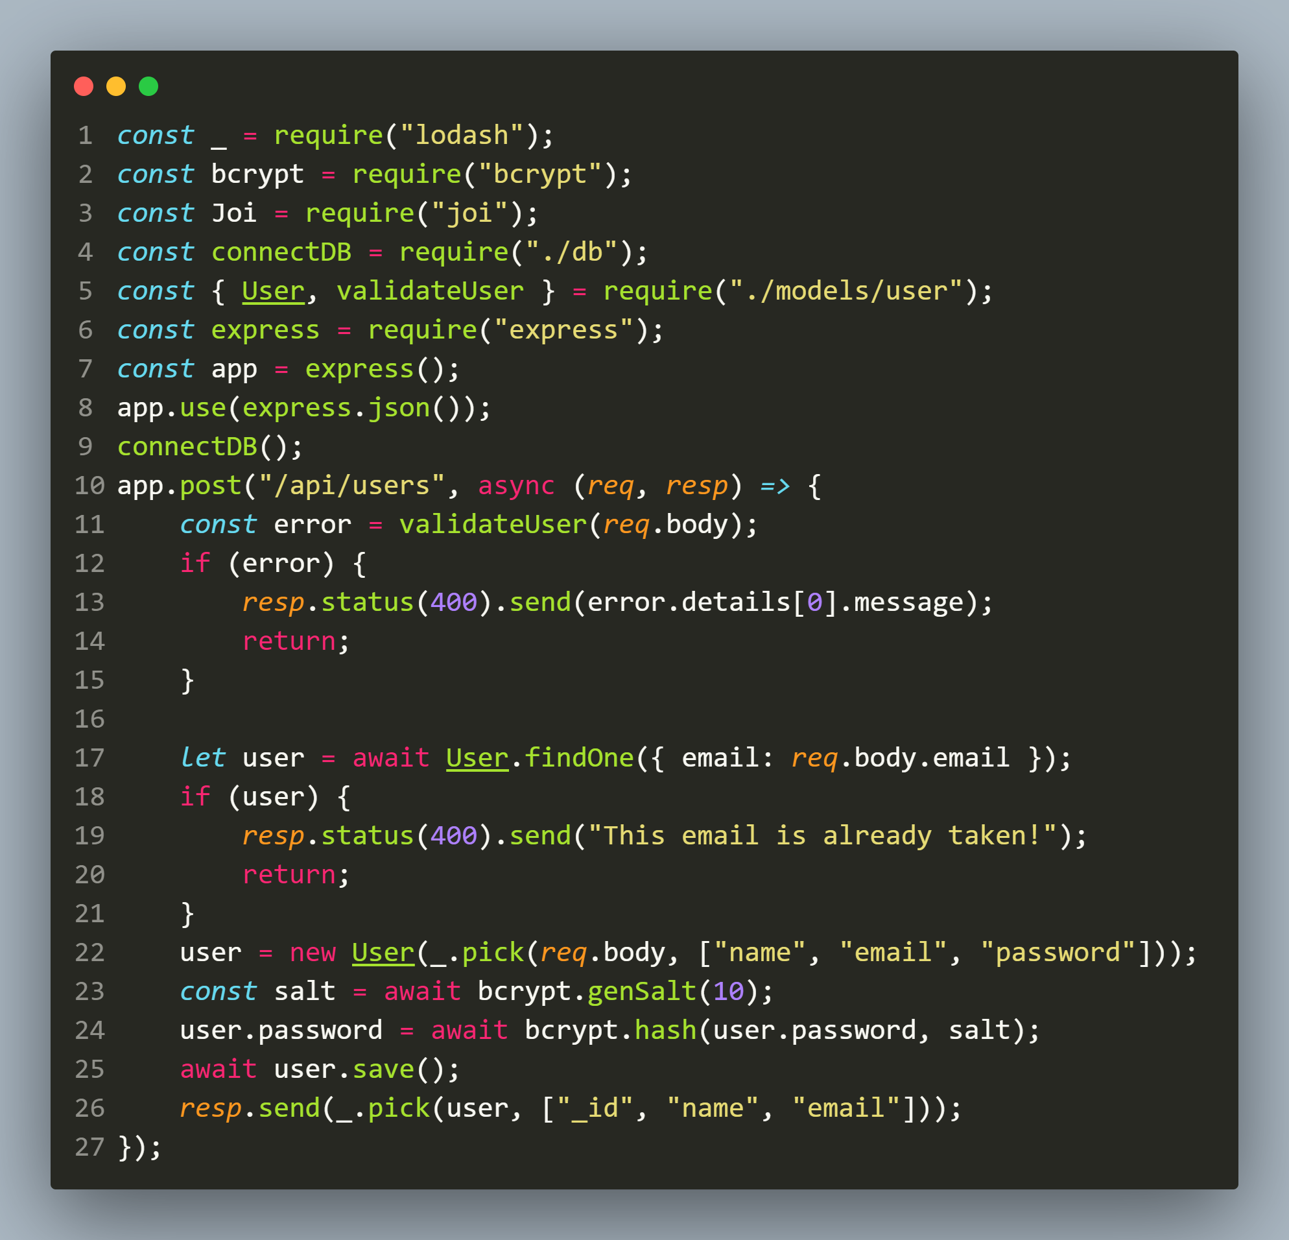
Improved app.js

Slide 58
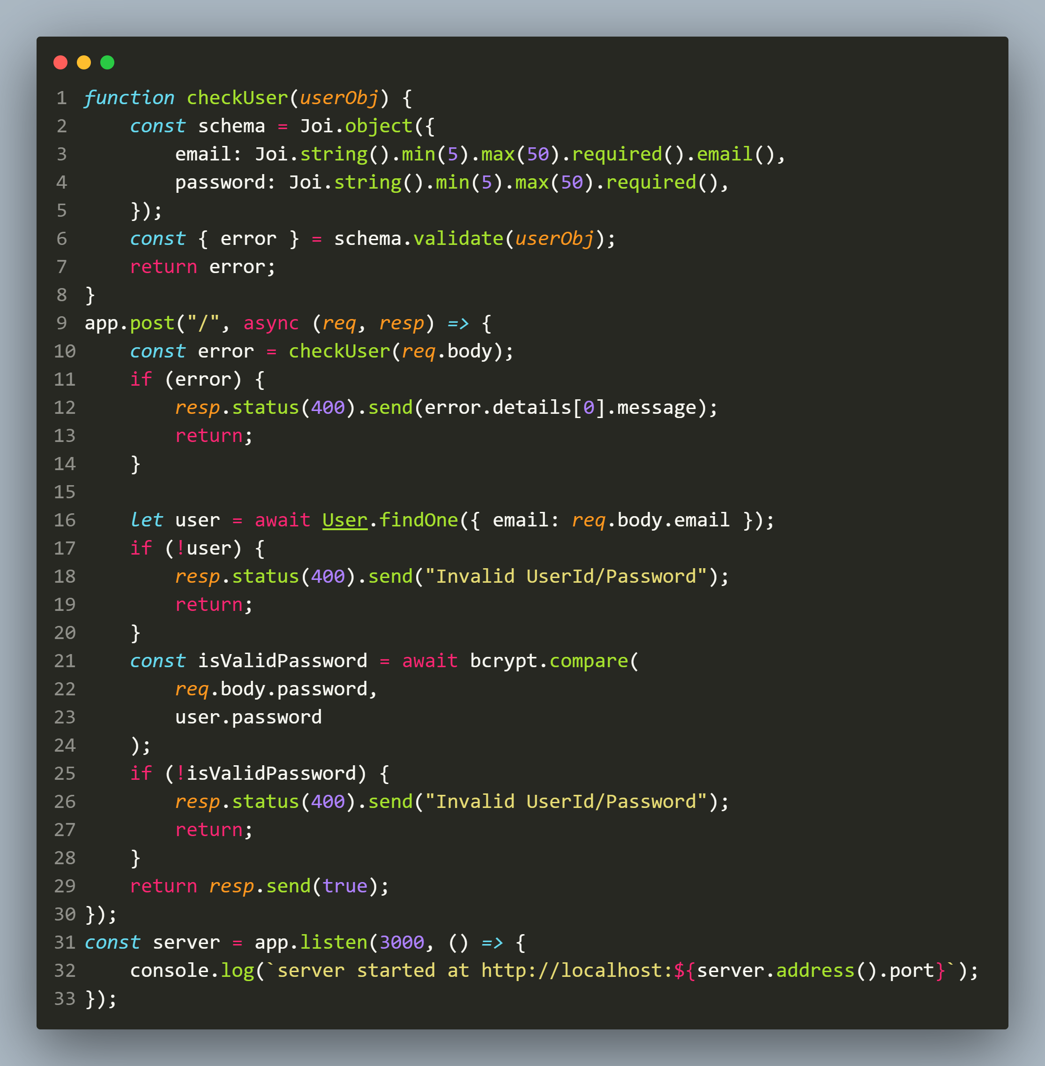
Improved app.js

Slide 59
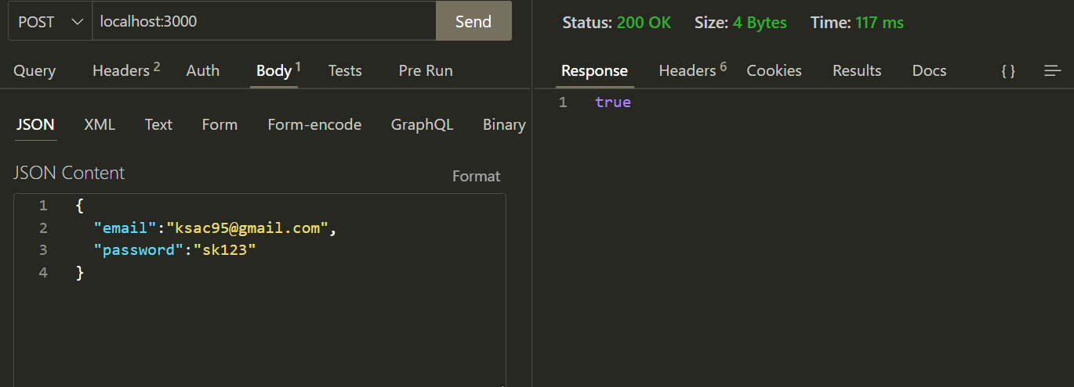
output

Slide 60
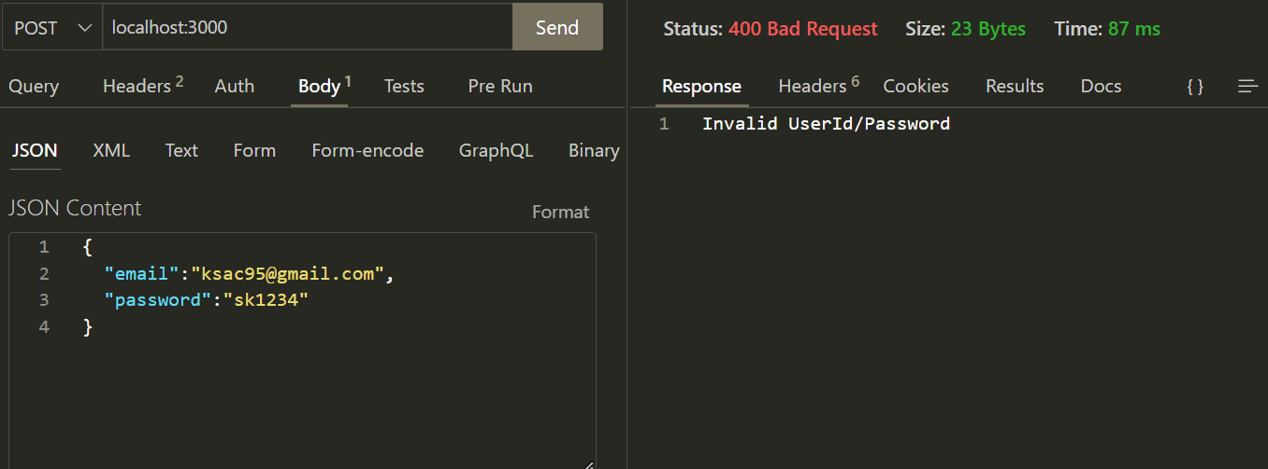
output

Slide 61
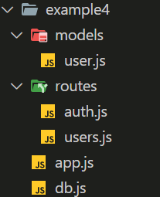
Exercise 86
Restructure the previous Register-Login application by making use of Express Router.
Use the following app structure:

